Slide 1
REINFORCEMENT PROJECT IN EXCEL
STUDENT PERFORMANCE
PRESENTED BY HARISH B

Slide 2
AIM:
To analysis the student academic outcomes and understand how performance varies across different groups.

Slide 3
OVERVIEW OF STUDENT PERFORMANCE DATASET
LUNCH TYPE
TEST PREPARATION
GENDER
Free/reduced
Standard
Completed
None
Female
Male
PARENTAL EDUCATION
RACE/
ETHNICITY
Associate’s Degree
Bachelor’s Degree
High School
Master’s Degree
Some College
Some High School
Group A
Group B
Group C
Group D
Group E

Slide 4
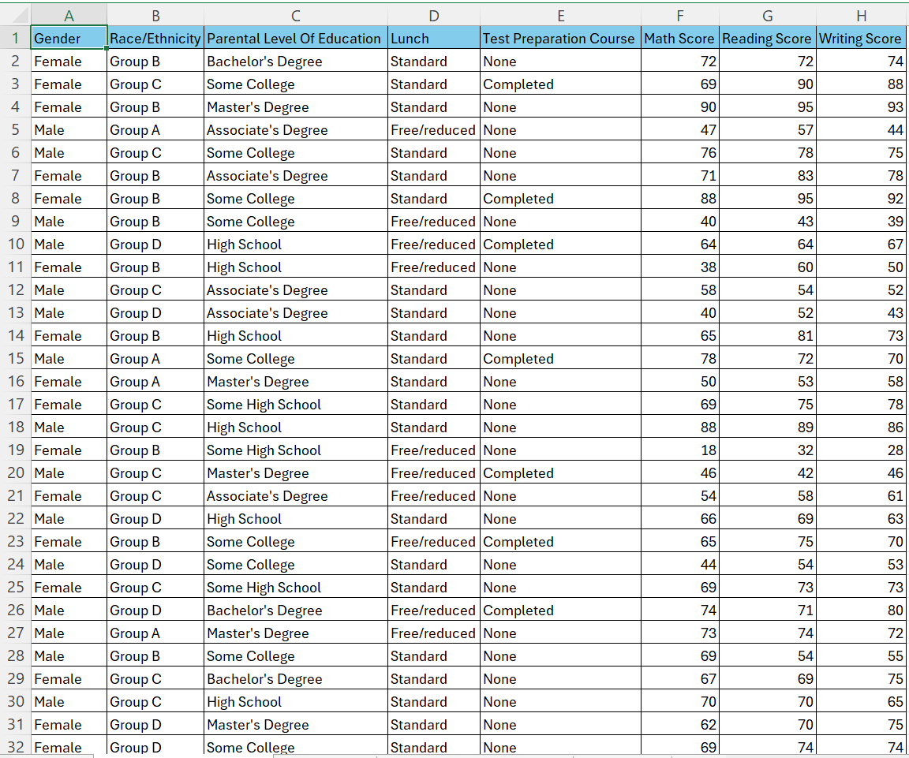
DATASET

Slide 5
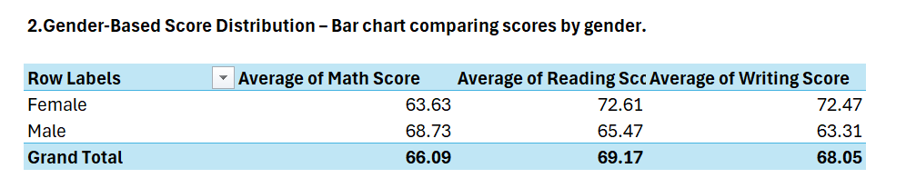
GENDER-BASED PERFORMANCE
Female students outperform male students across all subjects:
Math: Female – 72.47 | Male – 68.73
Reading: Female – 72.61 | Male – 65.47
Writing: Female – 63.63 | Male – 63.31

Slide 6
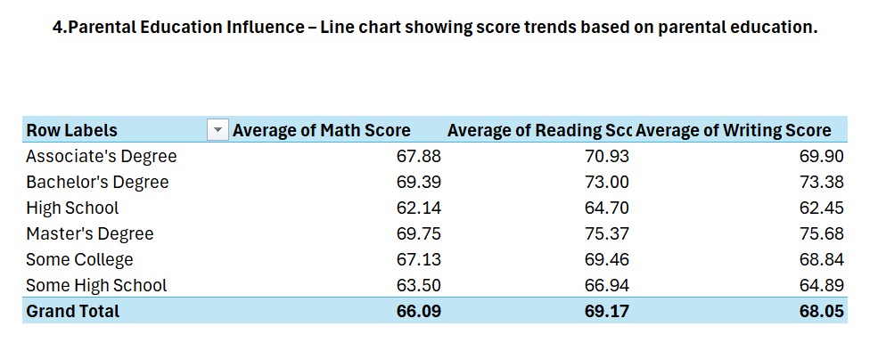
AVERAGE SCORE BY PARENTAL EDUCATION
Higher parental education levels correlate with higher student scores across all three subjects.
Students whose parents hold a Master’s or Bachelor’s degree tend to perform better on average.
Those with parents having only high school education show relatively lower performance, especially in Math and Writing.

Slide 7
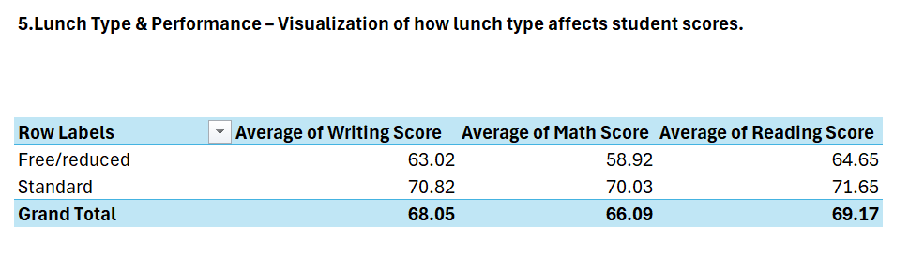
LUNCH TYPE & PERFORMANCE
Students with Standard lunch consistently achieve higher average scores across all subjects.
Students receiving Free/Reduced lunch show lower performance, with the largest gap often seen in Math scores.

Slide 8
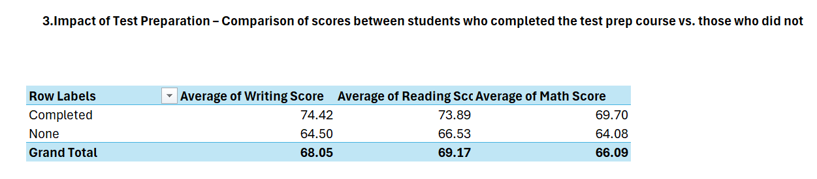
IMPACT OF TEST PREPARATION
Average Score Comparison (Example):
Math: Completed – 69.2 | None – 61.3
Reading: Completed – 72.5 | None – 65.4
Writing: Completed – 74.1 | None – 63.8

Slide 9
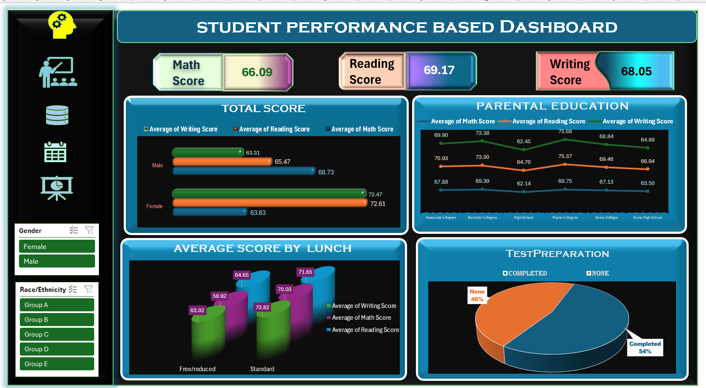
DASHBOARD

Slide 10
CONCLUSION
Parental education, lunch type, and test preparation strongly influence student performance across all subjects.
Students with higher parental education, standard lunch, and test prep score significantly better.
The dashboard and pivot table provide clear insights to make data-driven decisions for improving academic outcomes.

Slide 11
THANK YOU !

